Slide 1

Big Data Analysis of Amazon Review
Big Data Platform | Autumn 2023
Team Members
Nicole Young, Xiaobing Xu
Yixuan Chen, Boya Zeng

Slide 2
AGENDA
01
02
03
04
Project Overview
Data Process&EDA
Conclusion
Machine Learning Models

Slide 3
01
PROJECT
OVERVIEW
Big Data Platform | Fall 2023

Slide 4
Executive Summary
Business Problem:In the rapidly evolving e-commerce landscape, Amazon, a global leader in online retail, faces intense competition and ever-increasing customer expectations. The ability to understand customer preferences, predict their needs, and tailor the shopping experience is paramount. Amazon's vast repository of customer reviews and interaction data is underutilized, offering untapped potential to drive sales and improve customer satisfaction.
Goal: Leverage data analytics and machine learning to boost customer satisfaction, streamline marketing efforts, and drive sales growth.
Sentiment Analysis: Spark NLP pretrained model (sentimentdl_use_twitter) was employed to classify reviews into positive, negative, or neutral categories.
Product Recommendation System:Implemented using the Alternating Least Squares (ALS) algorithm in Apache Spark for collaborative filtering to develop a system that suggests products to users based on their preferences and behavior.
Customer Segmentation:Applied clustering technique - K-Means to segment customers into distinct groups based on purchasing behavior and preferences.

Slide 5
Business Objectives
Sentiment Analysis:
Objective: Analyze customer reviews to gauge sentiment towards products.
Business Impact: Helps in identifying products that are well-received or those that require improvements. Guides product development and customer support strategies.
Product Recommendation System:
Objective: Develop a model to recommend products to customers based on their past reviews and ratings.
Business Impact: Enhances customer experience through personalized recommendations, increasing sales and customer loyalty.
Customer Segmentation:
Objective: Segment customers based on their purchasing patterns and review behaviors.
Business Impact: Enables targeted marketing campaigns, improves customer engagement, and identifies key customer segments.

Slide 6
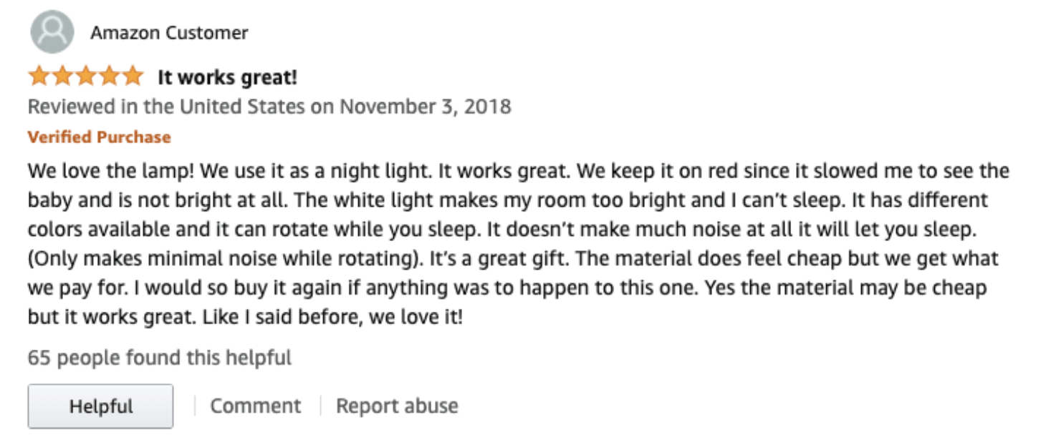
Data Source
Amazon Customer Reviews Dataset.
Fields in Dataset:
marketplace: Identifies the country of the Amazon marketplace.
customer_id: A unique identifier for the author of the review.
review_id: Unique ID of each review.
product_id and product_parent: Identifiers for the reviewed products.
product_title and product_category: Provide context about the product.
star_rating, helpful_votes, total_votes: Metrics for review helpfulness and rating.
vine and verified_purchase: Indicators of review's source and authenticity.
review_headline, review_body, review_date: Text and metadata of the review.
https://www.kaggle.com/datasets/cynthiarempel/amazon-us-customer-reviews-dataset/data?select=amazon_reviews_us_Apparel_v1_00.tsv

Slide 7
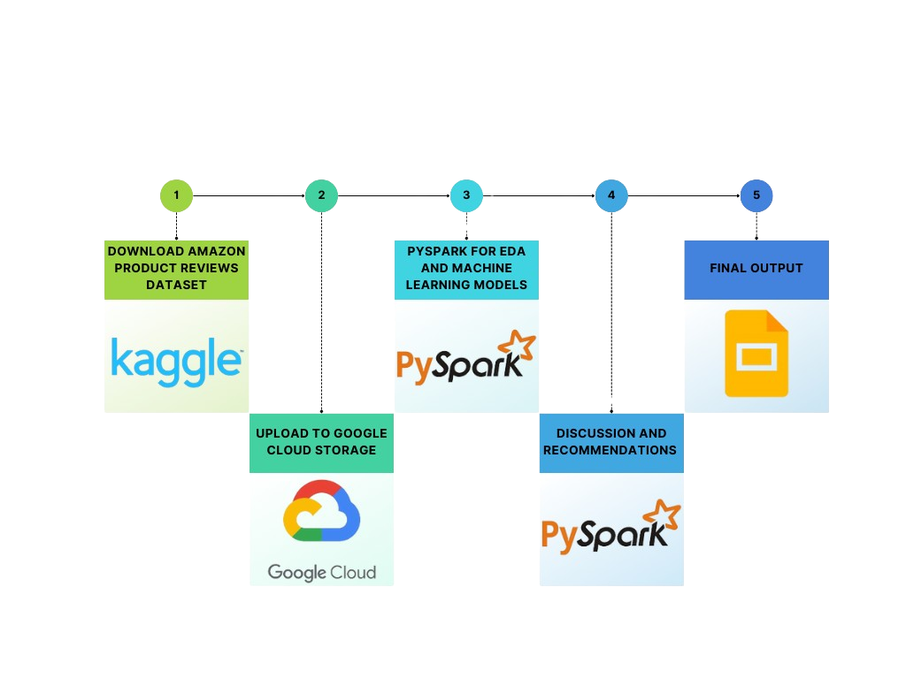
Project Steps

Slide 8
02
Data Process
& EDA
Big Data Platform | Fall 2023

Slide 9

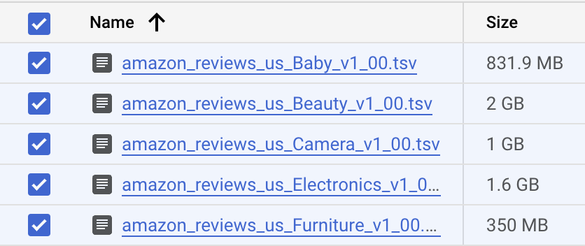
Raw Data
Step1
Use Kaggle API download
zip file to GCP
Step2
Unzip the file in Cloud shell
Step3
Upload unzipped file back to GCS

Slide 10
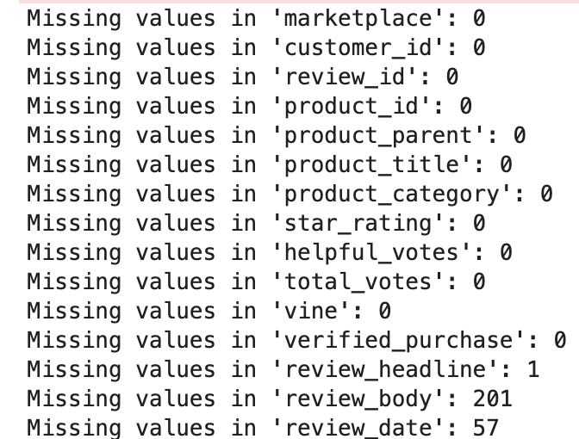
Data Cleaning
Remove any unwanted characters
#, %, ^, //, etc.
Convert to all lowercase text for consistency
Check for duplicates based on a column
Remove missing values

Slide 11
Summary Statistics
 | star_rating | helpful_votes | total_votes
count | 619630 | 619630 | 619630
mean | 4.13 | 1.97 | 2.47
std | 1.33 | 21.39 | 22.61
min | 1 | 0 | 0
max | 5 | 8937 | 9072

Slide 12
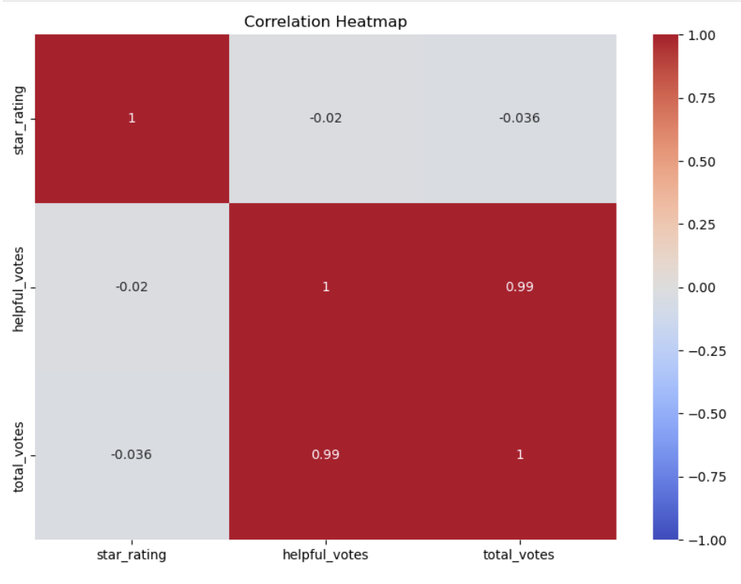
Correlation heatmap
1. No significant correlation between 'star_rating' and 'helpful_votes' (-0.02).
2. No significant correlation between 'star_rating' and 'total_votes' (-0.036).
3. The correlation coefficient between 'helpful_votes' and 'total_votes' is very high at 0.99, indicating a very strong positive linear relationship.

Slide 13
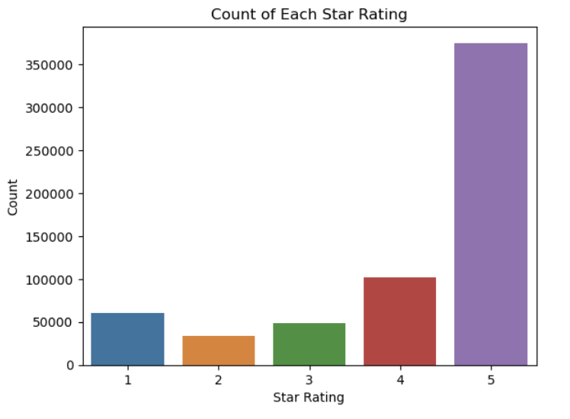
Distribution of Star Ratings
1. The majority of our reviews are 5-star, indicating high customer satisfaction.
2. Approximately 15.15% of the reviews are in the 1 or 2-star rating range, indicating potential areas for improvement.
3. Reviews with a 3-star rating, which account for roughly 8%, suggest a moderate viewpoint and could offer valuable insights for enhancement.

Slide 14
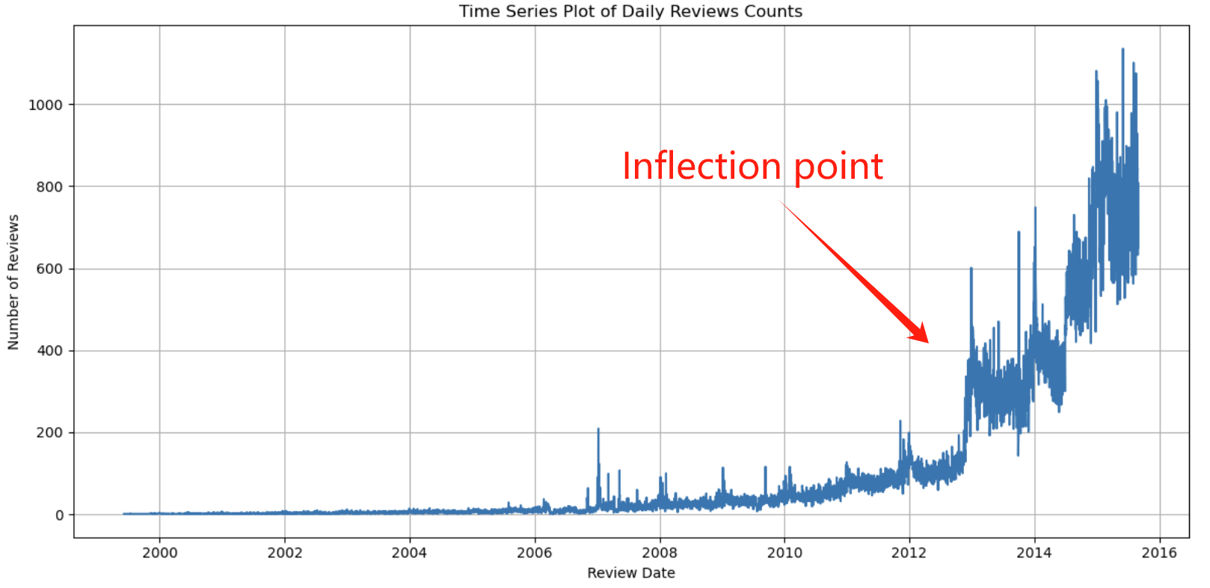
Time Series Plot of Review Counts
1. There's a clear trend of increasing review counts over time.
2. The graph depicts an sudden rise in review counts beginning in 2013, marking a distinct inflection point in the trend.
3. There may be patterns or seasonality in the data, such as certain times of year (holidays), but it is not immediately clear from the graph without further context.

Slide 15
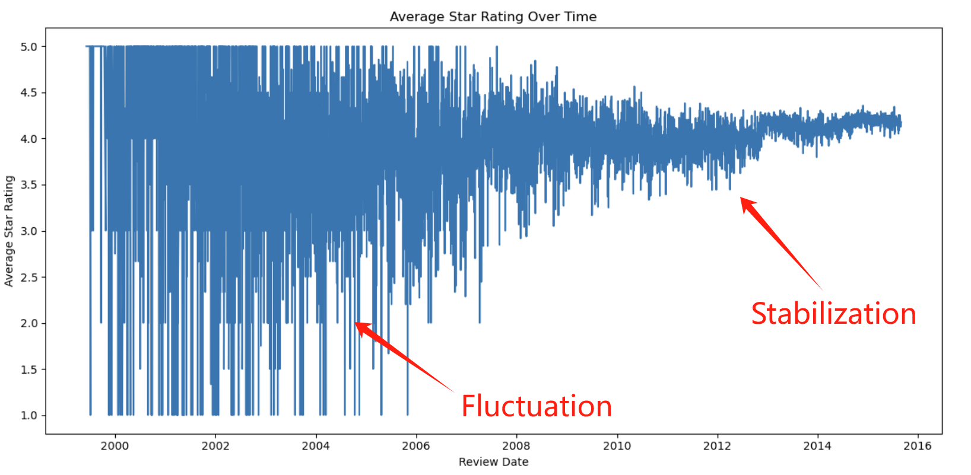
Average Star Rating Over Time
1. Initial Fluctuations (2000-2002): There's a high variability in the ratings, indicating inconsistent feedback during this period.
2. Stabilization (2003-now): The average rating seems to stabilize around the 3.5 to 4.5 range with less drastic fluctuations. This could indicate a period of consistent product or service quality, or perhaps more consistent expectations from reviewers.

Slide 16
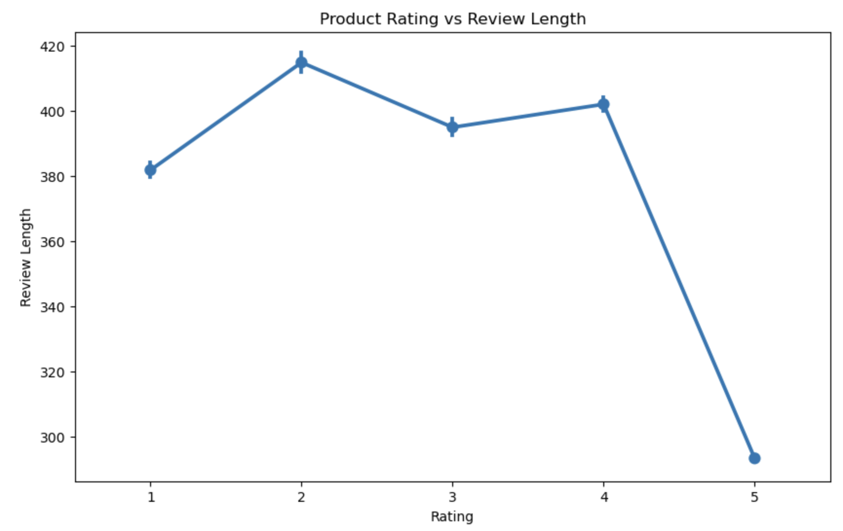
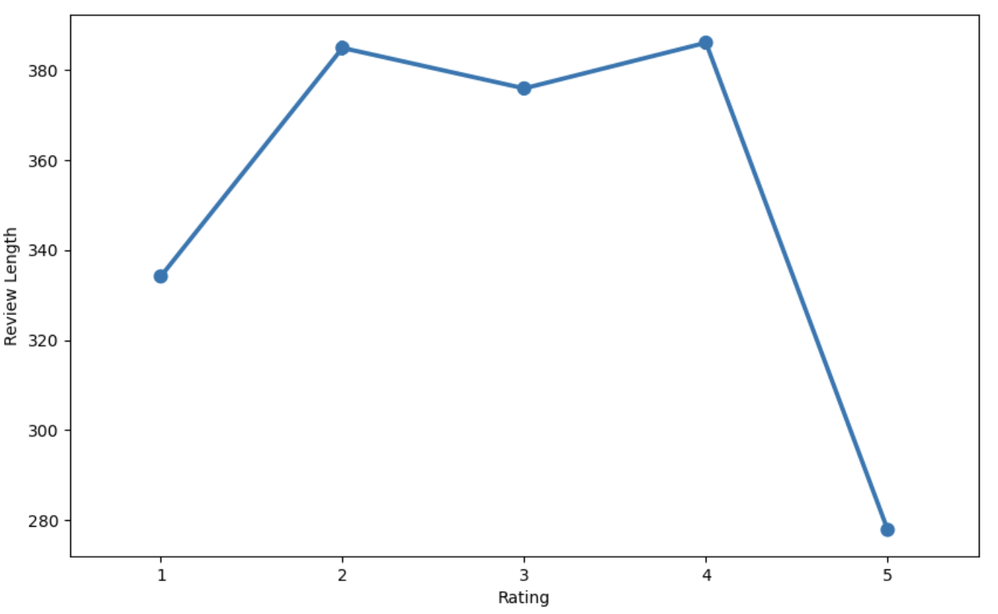
Star Ratings & Review Length
1. The product review word length are longer when the rating is below 5, indicating that people might write longer posts for unsatisfying products.
2. People also tend to write less and just give 5 star ratings when they satisfy the product.

Slide 17
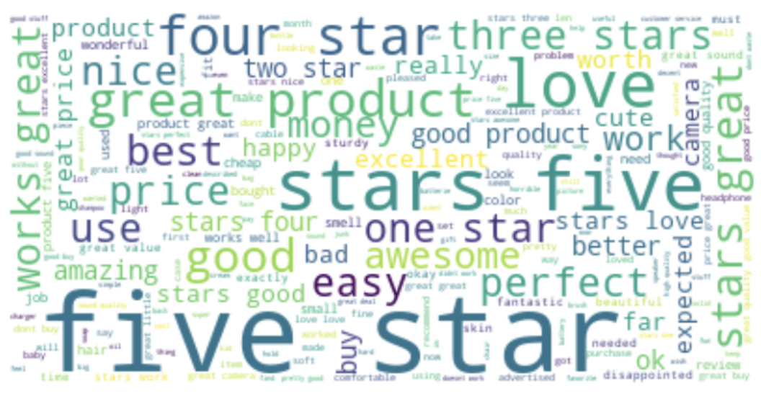
Word Clouds
Word clouds for review headline
1. The most prominent words, such as "five", "star", "love", "great", "good", and "best", suggest that many of the reviews are positive. Words like "amazing", "perfect", "excellent", "easy", and "nice" contribute to the understanding that the sentiment of the reviews is generally positive.
2.Smaller words, such as "disappointed", "okay", "bad", and "cheap", negative reviews appear less frequently than positive comments.

Slide 18
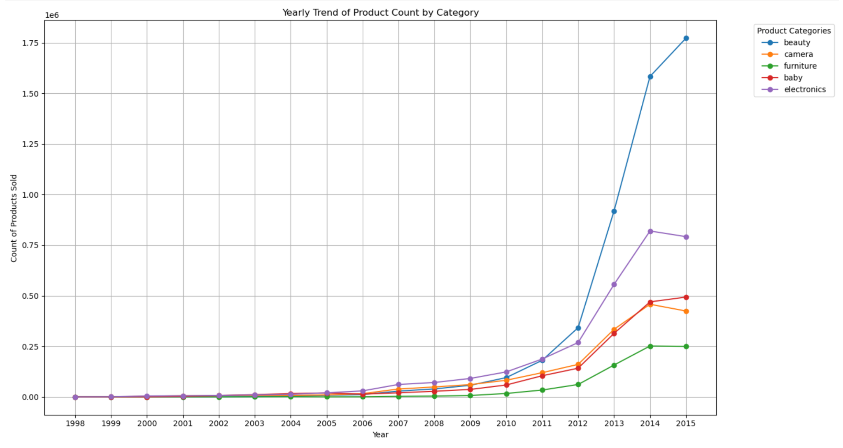
Sold Products by Category
The beauty category has the largest increase on trend of product count by category.
Notes:
In 2015, Amazon.com was the first to offer "Black Friday in July" deals on what they called "Prime Day", promising better deals than on Black Friday. Amazon repeated the practice in 2016 and 2017, and other companies began offering similar deals.[19]

Slide 19
Models
Sentiment Analysis
Customer Segmentation
Recommendation System

Slide 20
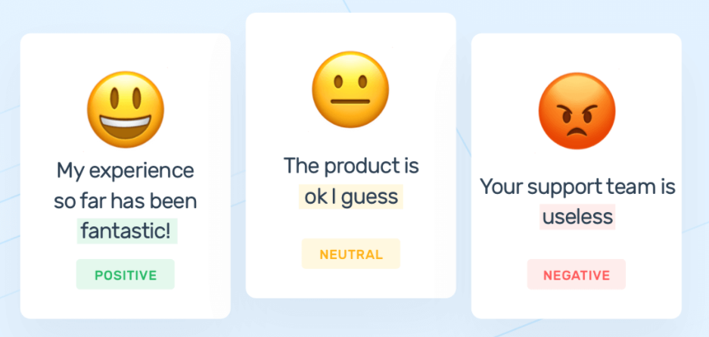
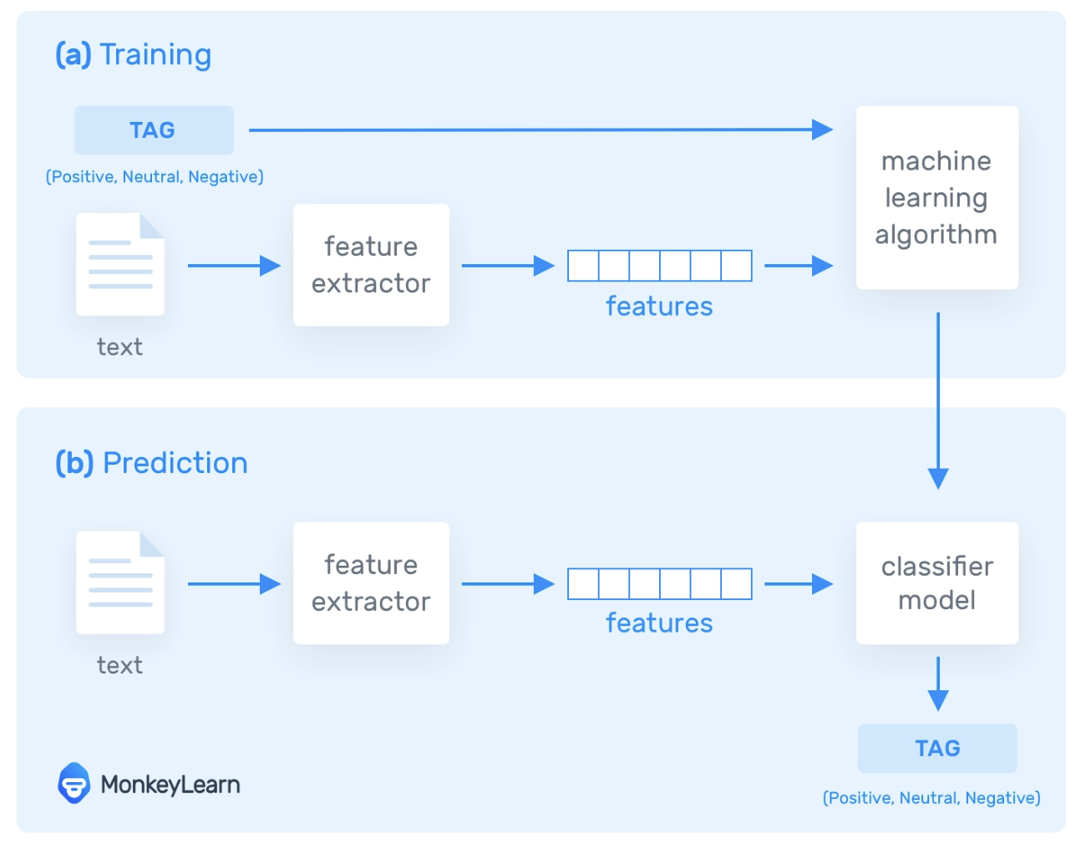
Sentiment Analysis
The process of using NLP and machine learning to classify sentiments (positive, negative, neutral) in text data
Our Problem
Classify the sentiment of an Amazon product review as Positive, Neutral, or Negative.
How does it Work

Slide 21
Sentiment Analysis
Model Pipeline
Document Assembler
Sentence Detector
Tokenizer
Sentence Embeddings
Sentiment Detector
Converts raw text into a structured format
Splits the text into individual sentences
Breaks sentences into tokens (words)
Uses Universal Sentence Encoder to convert sentences into numerical representations
Analyzes the embeddings to determine sentiment, utilizing a Spark NLP pre-trained model (sentimentdl_use_twitter)

Slide 22
Sentiment Analysis
Model Evaluation
 | Logistic Regression Model
Star Rating | Accuracy = 0.6711058784664937
Sentiment | Accuracy = 0.7800860932363265
Class positive (Index 0) | Precision = 0.8134483314231166, Recall = 0.8790540895710681, F1 Score = 0.8449796863182262
Class negative (Index 1) | Precision = 0.763232640513266, Recall = 0.7294681876008027, F1 Score = 0.7459685430688879
Class neutral (Index 2) | Precision = 0.14800381740098617, Recall = 0.06459114257948077, F1 Score = 0.08993379403663074
Modeling Improvement
Imbalance issues /Missing data /ngram for processing data/parameters adjusted for predicting
Drop Neutral, Improved Accuracy: 0.8776766997207375

Slide 23
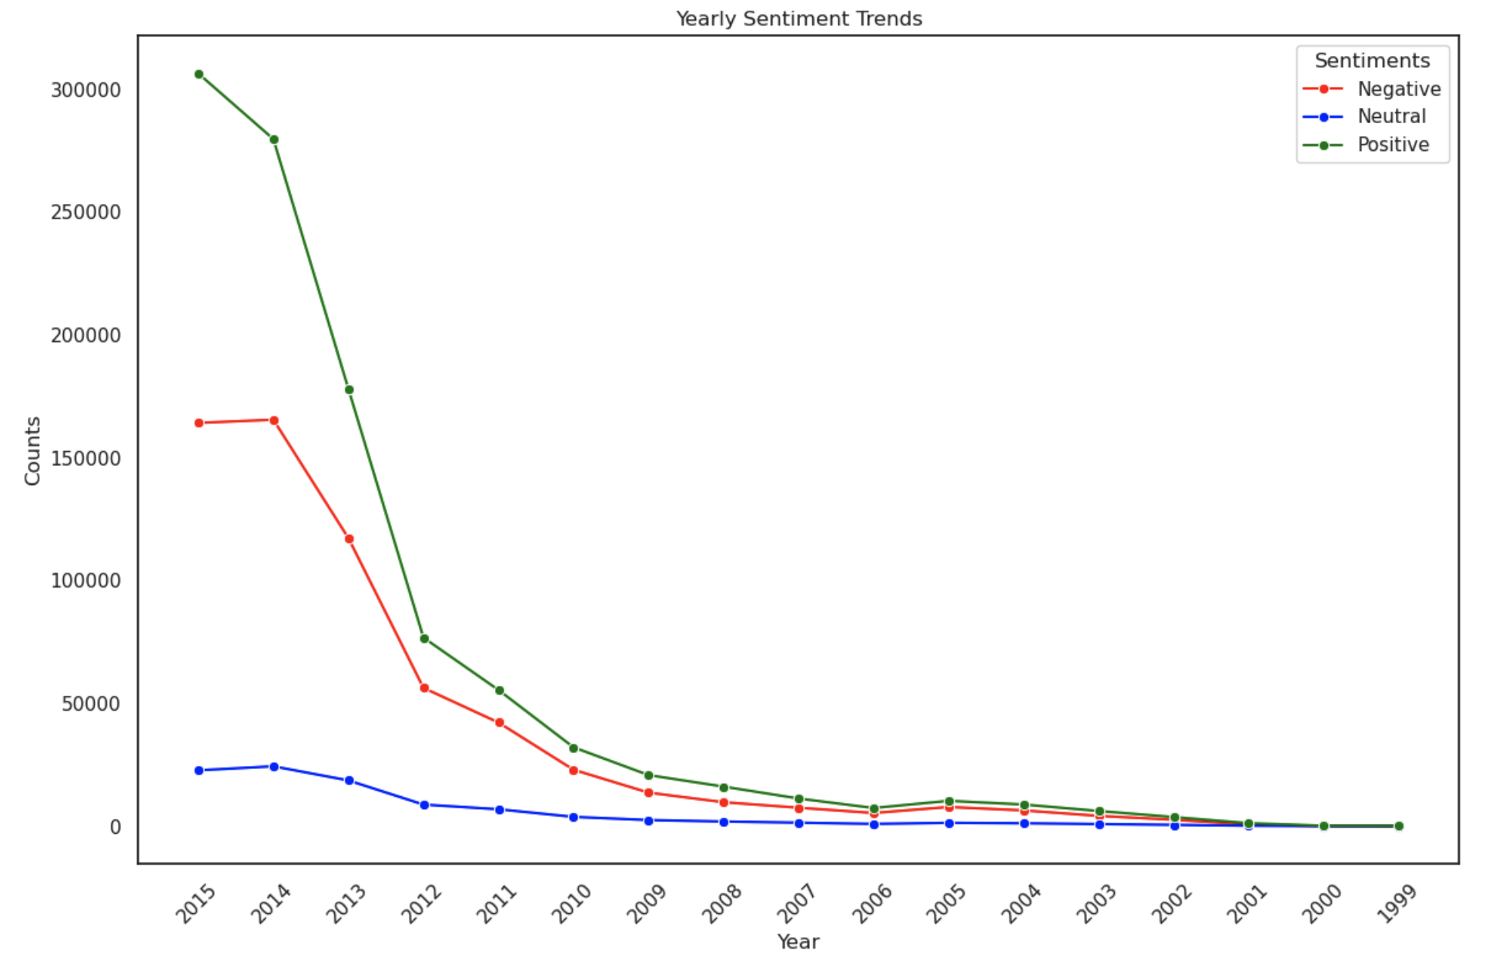
Sentiment Analysis
Trend Analysis
The number of positive and negative sentiment significantly increased over years especially after 2012.
Higher increment for positive reviews compared to negative reviews after 2012
The negative reviews become stable after 2014
Notes:
In 2015, Amazon.com was the first to offer "Black Friday in July" deals on what they called "Prime Day", promising better deals than on Black Friday. Amazon repeated the practice in 2016 and 2017, and other companies began offering similar deals.[19]

Slide 24
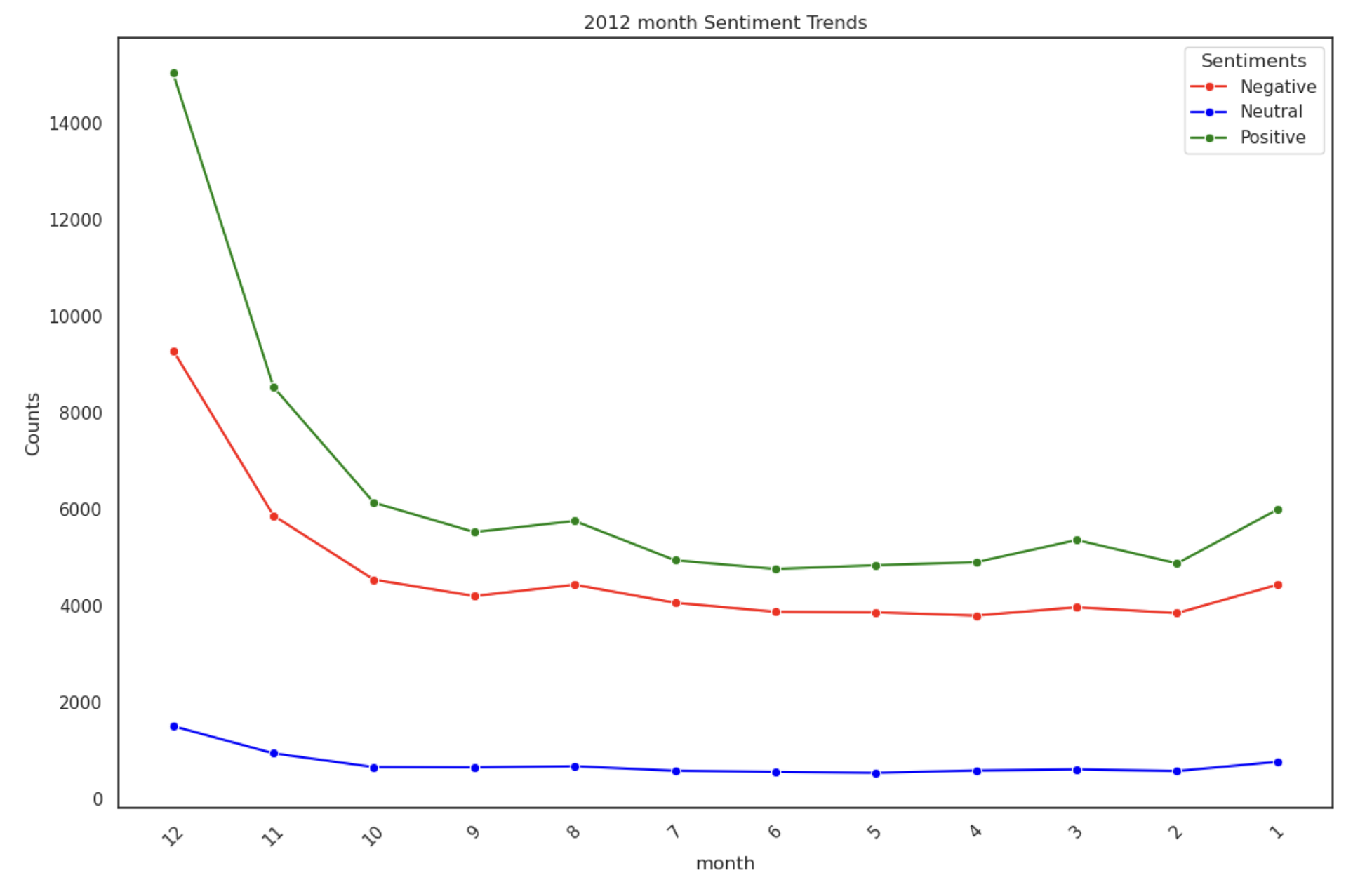
Sentiment Analysis
Trend Analysis
Seasonal or Monthly Trends: There appears to be a significant decline in the counts of sentiments from the beginning of the year towards the following months. However, after the November, both positive and negative reviews increased.

Slide 25
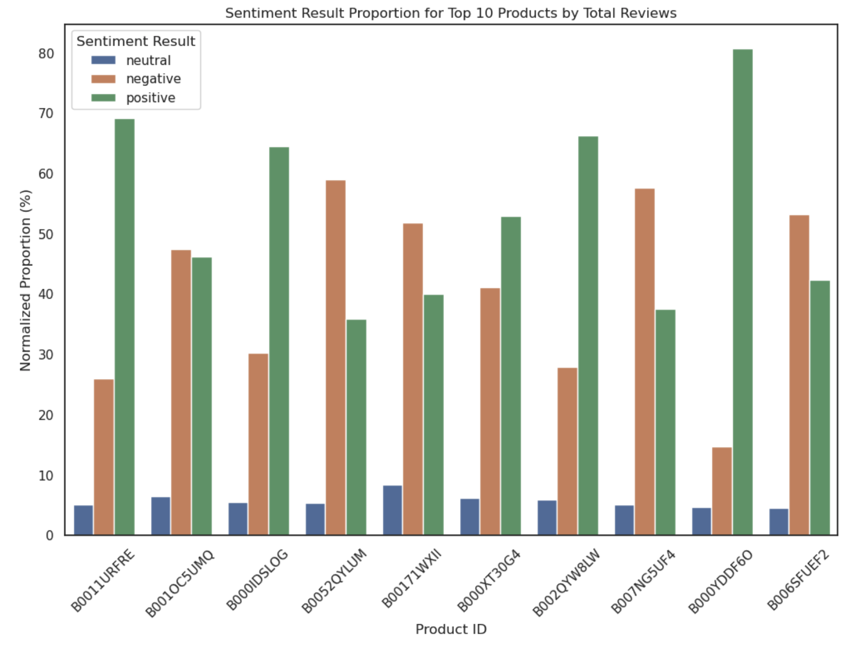
Sentiment Analysis
4 products have high proportion of negative sentiment result but with fair star_rating scores
 | product_id | avg_star_rating
1 | B0052QYLUM | 3.874745228830832
2 | B00171WXII | 4.656218402426694
3 | B006SFUEF2 | 3.8251057827926656
4 | B007NG5UF4 | 3.9677570093457946
*
*
*
*

Slide 26
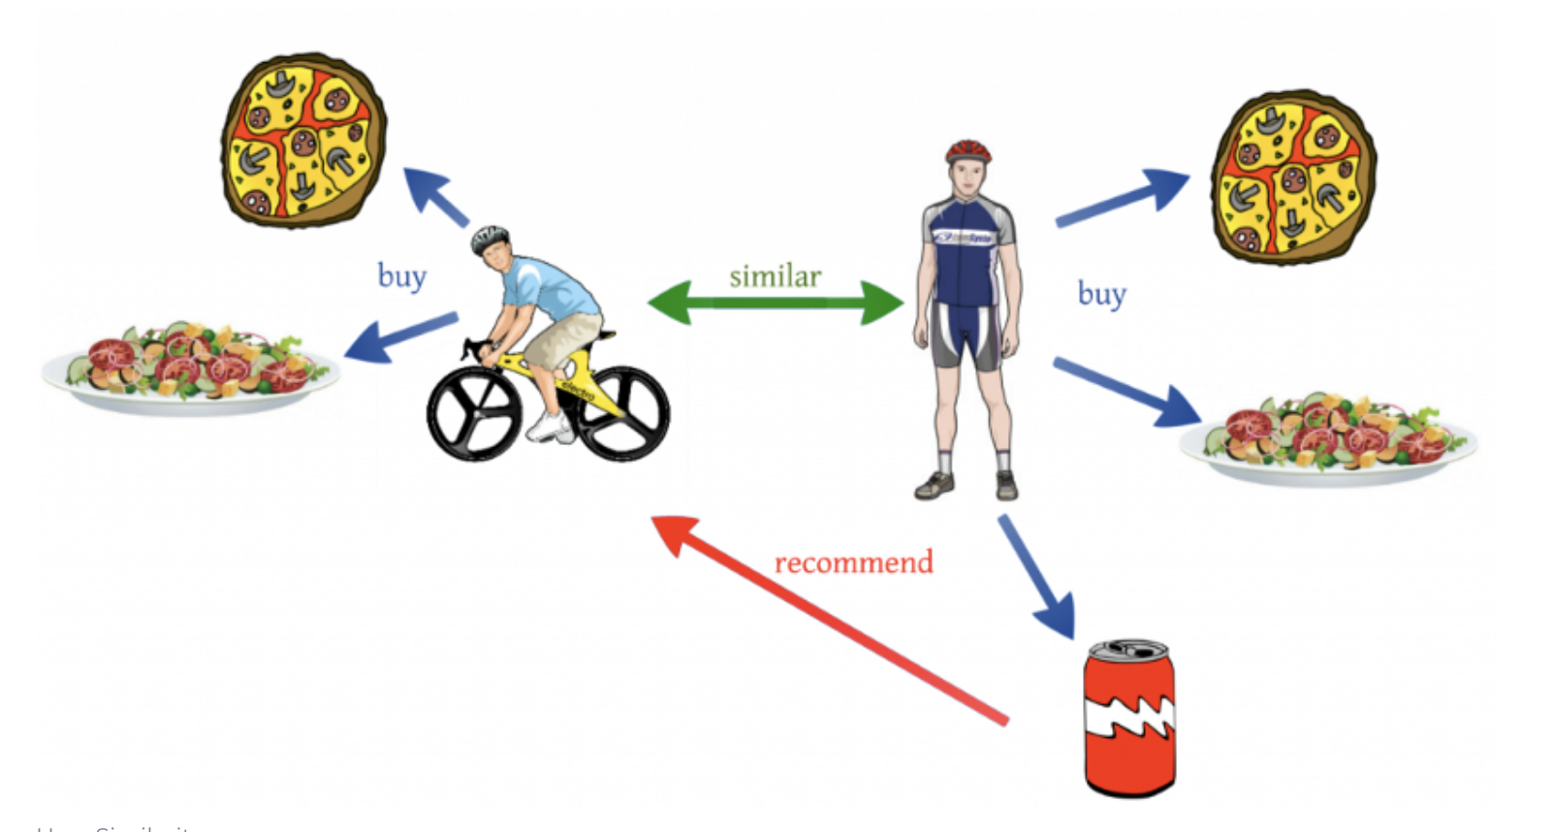
Recommendation System
The process of recommending products to users based on their past reviews and ratings.
Our Problem
Recommend products to users using ALS (Alternating Least Squares

Slide 27
Recommendation System
Method:Alternating Least Squares(ALS)
ALS is a popular algorithm used in collaborative filtering for making recommendations, particularly in the context of large-scale matrix factorization problems.
Why ALS?
Scalability: ALS can be parallelized and distributed across multiple nodes, making it suitable for large datasets.
Avoiding Overfitting: The ALS algorithm in Spark includes regularization parameters that help prevent overfitting.
Cold Start Problem Mitigation: While ALS faces challenges with new users or items (cold start problem), it can still provide reasonable recommendations based on the overall structure of the user-item interaction matrix.

Slide 28
Recommendation System
Process Description
Data Preparation:
StringIndexer: Converts string identifiers to numeric indices.(ALS in Spark requires numeric IDs.)
ALS Model Initialization:
The model is configured to drop any cold start occurrences and only produce non-negative predictions.
Hyperparameter Tuning:
A parameter grid is built for cross-validation. It tests combinations of the ALS hyperparameters: rank, max iterations, and regularization parameter.
The process evaluates the model's performance using the Root Mean Square Error (RMSE) metric.
Cross-validation:
4-fold cross-validation used to find the best model parameters.
Best Model Selection:
The best model from the cross-validation is selected based on the performance (lowest RMSE).
Making Predictions:
The best ALS model is used to make predictions on the test dataset.

Slide 29
Recommendation System
Rank=5
The model capturing 5 different dimensions or aspects of user-item interactions.
RMSE=1.69
MaxIter=5
ALS algorithm went through 5 complete passes to converge on a solution
On average, the model's predictions are about 1.696 rating units away from the actual ratings given by the users.
RegPara=1.0
Regularization parameter =1.0 suggests that the model has applied a significant level of regularization.
The RMSE value should be considered in the context of your dataset's rating scale. For example, if ratings are on a 1-5 scale, an average error of 1.696 could be seen as quite significant.

Slide 30
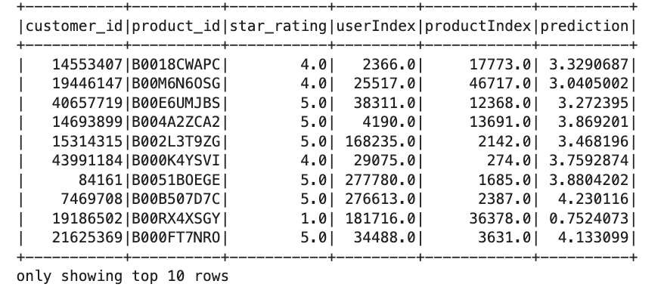

Recommendation System
Result
Personalized Product Recommendations:
E-commerce and Retail: Use the system to suggest products to customers based on their past purchases or browsing history. This can increase sales by showing customers items they are likely to buy.
Targeted Marketing:
Personalized Promotions: Use the recommendation engine to identify products that specific customer segments are likely to purchase and target them with specialized marketing campaigns or promotions.
n

Slide 31

Customer Segmentation
The process of dividing a customer base into groups with similar characteristics or behaviors
Our Problem
Cluster Amazon customers based on their reviewing behavior using K-means Clustering

Slide 32
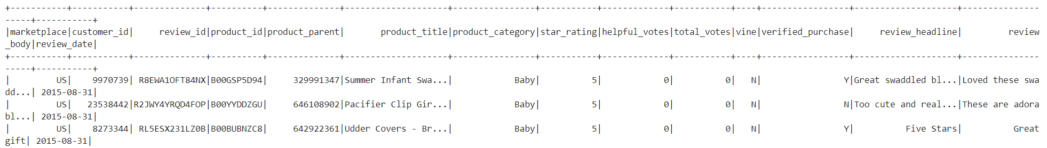
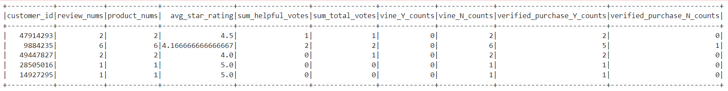
1. Create customer based dataset
Get customer based data
Find optimal k
Build model
Cluster definition
Business suggestion
Original dataset:
Customer based dataset:

Slide 33
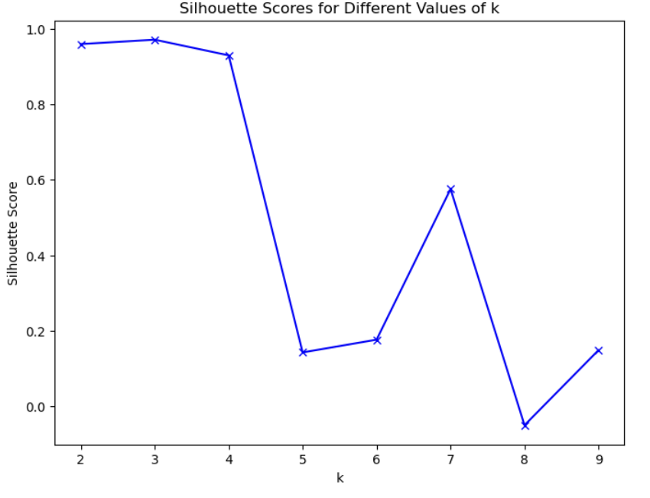
2. Find optimal k value
Get customer based data
Find optimal k
Build model
Cluster definition
Business suggestion
1. The silhouette score is a metric used to evaluate the quality of clusters in a clustering analysis. It measures how similar each data point in one cluster is to the data points in the same cluster compared to the nearest neighboring cluster. The silhouette score ranges from -1 to 1, with higher values indicating better cluster separation and cohesion.
2. Inspection point at k=4, with 0.93 silhouette score.

Slide 34

3&4. Build model & Cluster definition
Get customer based data
Find optimal k
Build model
Cluster definition
Business suggestion
Check statistics of each cluster:
Define a new variable: product review engagement
0/1: low engagement
3: middle engagement
2: high engagement

Slide 35

5. Business suggestion
Get customer based data
Find optimal k
Build model
Cluster definition
Business suggestion
1. Low engagement
Target marketing strategies: Implement targeted marketing strategies to increase customer engagement, such as email campaigns that encourage reviews in exchange for a discount on future purchases.
Feedback Loop: Send out surveys or feedback requests to understand why their engagement is low and what could be improved in their experience.
Apply New Recommendation System: To increase their interaction with our products or services.
2. Middle & High engagement
Community Building: Invite these customers to a VIP club or community where they can share their experiences, get early access to new products, and feel more connected to the brand.
Extra Access: Provide early access to new products, special editions, or exclusive previews as a reward for their high engagement. Put them into experiment group while performing A/B testing.

Slide 36
Future Work
Advanced Machine Learning and NLP Techniques
Aspect-Based Sentiment Analysis: Move beyond overall sentiment to analyze specific aspects of products, like quality, price, or usability.
Deep Learning: Incorporate deep learning models for more nuanced sentiment analysis and enhanced recommendation systems.
Larger and More Diverse Data Integration
Cross-Platform Analysis: Incorporate reviews and ratings from other e-commerce platforms for a more comprehensive analysis.
Real-Time Data Processing
Streaming Data: Implement real-time analysis of customer reviews using streaming technologies like Apache Kafka and Spark Streaming.

Slide 37
Conclusion
The Amazon Review Analysis project successfully integrated Sentiment Analysis, Product Recommendation System, and Customer Segmentation, showcasing the immense value of data analytics in enhancing customer experiences and guiding business strategies.
Sentiment Analysis provided crucial insights into customer opinions, aiding in product improvement and responsive decision-making.
The Product Recommendation System personalized shopping experiences, significantly boosting sales through targeted product suggestions.
Customer Segmentation enabled precise marketing strategies and improved service offerings by categorizing customers based on behavior and preferences.

Slide 38
Thank
You!
Big Data Platform | Fall 2023

